Slide 1
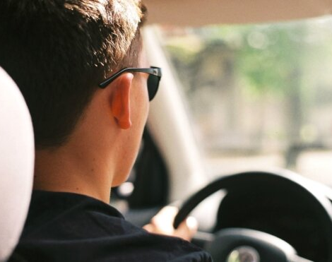
Driver Drowsiness Detection System using Facial Analysis
Francisco Lozano
Depaul University
CSC 481 section 701

Slide 2
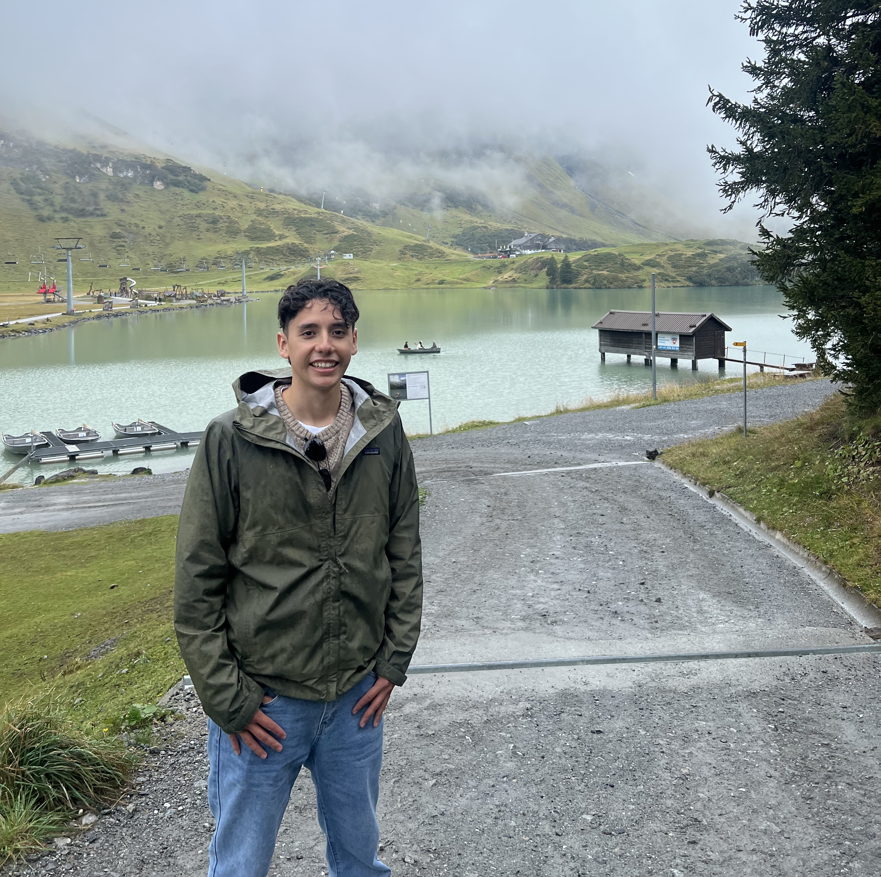
Bio
Masters in Data Science, Computational Methods Concentration
I love the Outdoors
climbing/hiking mountains
Camping
Etc.
I am a Software Engineer for a Research project called SAGE
Socials
GitHub: https://github.com/FranciscoLozCoding
LinkedIn: https://www.linkedin.com/in/franlozdata/
Email: flozano2@depaul.edu

Slide 3
Introduction
Problem Statement: Develop an automated driver drowsiness detection system that uses facial analysis to identify signs of drowsiness, such as “droopy” eyes.
Objective: Create a classification system to determine Drowsy/Non-Drowsy based on one image.
Importance: Most driver drowsiness detection systems rely on video; using a single image for classification could speed up computation.

Slide 4
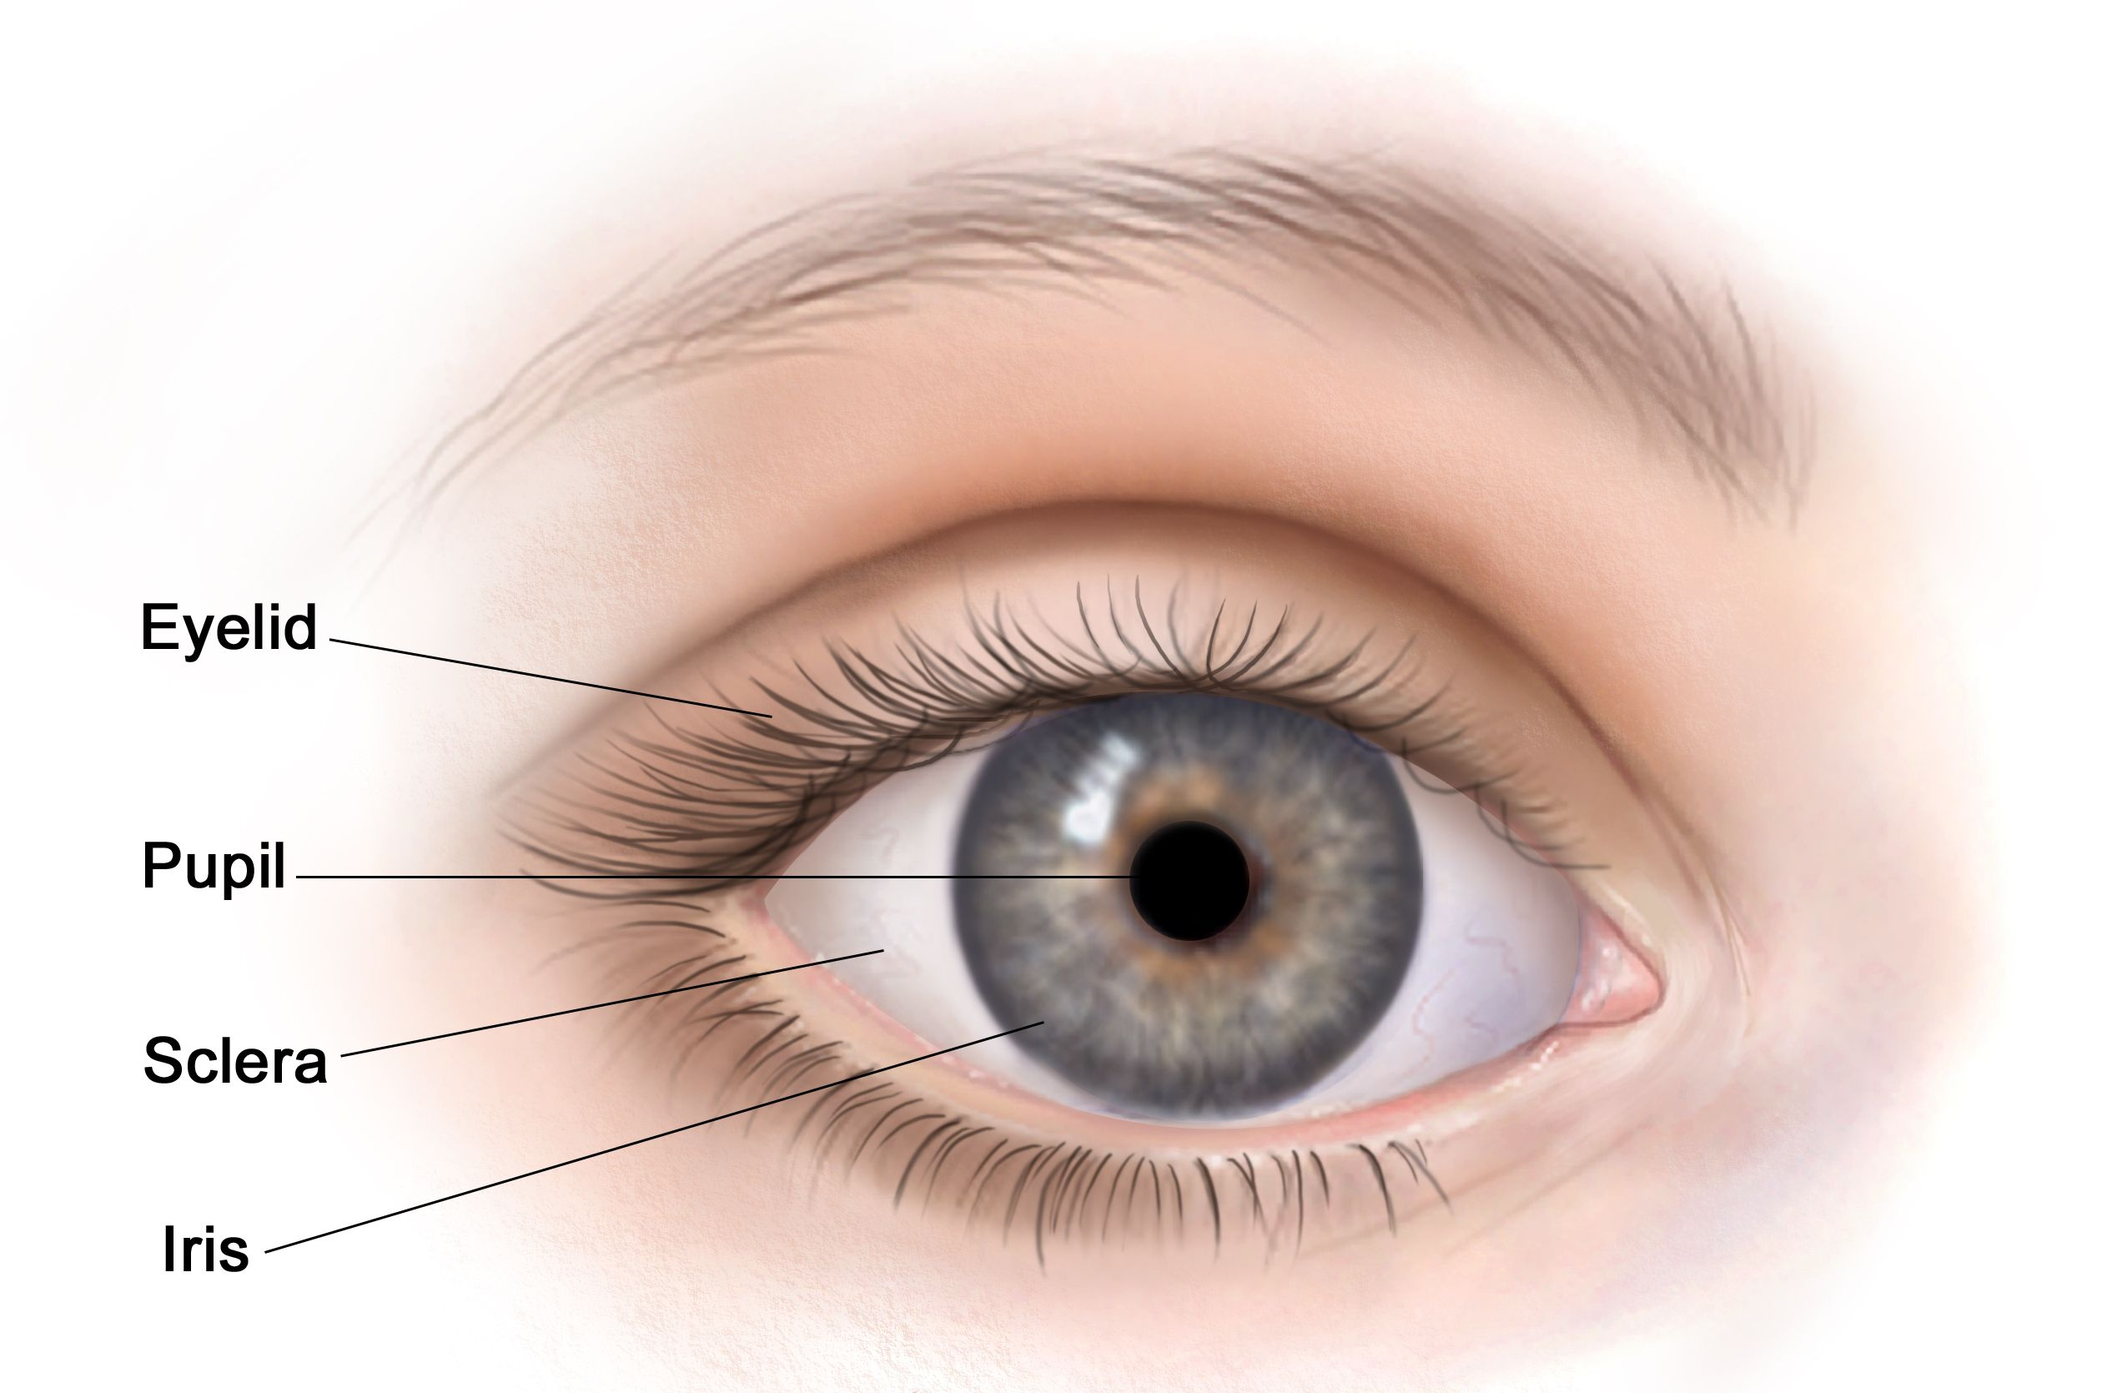
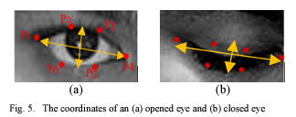
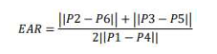
Background & Context
In this project we will be looking at the Pupil, Sciera, Iris, and Eyelid
Assuming when someone is drowsy their eyelid will cover more of their Pupil, Sciera, etc. (aka ”Droopy” eyes)
The Eye Aspect Ratio (EAR), closed eye has an EAR of 0
Notes:
Context or Background: Provide necessary background information.
Key Terms or Concepts: Define any specific terms relevant to your project.

Slide 5
Methodology
Tools and Technologies: Python, Kaggle, OpenCV, Dlib, NumPy, SciPy, and others
Phases:
Data Preprocessing
Algorithm Building
Evaluation
Notes:
Tools and Technologies: List the main tools, frameworks, and libraries (e.g., OpenCV, scikit-learn, ThreadPoolExecutor in Python, etc.).
Steps or Phases: Describe the main steps you followed in your project. Examples might include data preprocessing, model selection, feature engineering, training, etc.

Slide 6
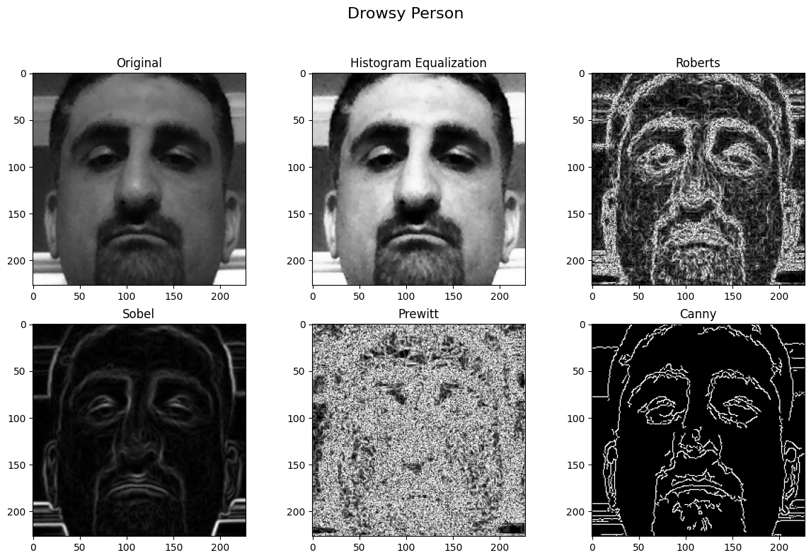
Dataset & Data Prepocessing
Dataset Overview: Driver Drowsiness Dataset (DDD) Included 41,790 RGB Images of cropped driver faces with two classes [“Drowsy”, “Non-Drowsy”]
Data Processing: Used Histogram Equalization and increased the images to 61.8k by adding images with Gaussian or Salt & Pepper noise. (Dataset Generated)
Before deciding to use Histogram Equalization I played around with Edge Filters but they gave bad results.
Notes:
Dataset Overview: Brief description of the dataset you used, including size, type, and source.
Data Processing: Briefly explain any data processing or cleaning steps you implemented, such as resizing images, normalizing values, or augmenting data.

Slide 7
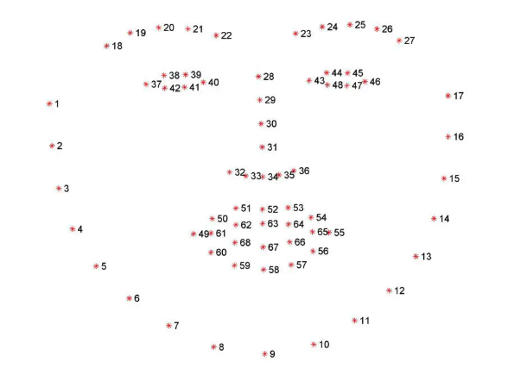
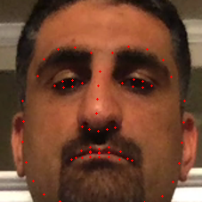
Algorithm 1
Model/Algorithm Choice: Facial landmark can detect eyes, mouth, nose, etc.
Why This Model: This algorithm can capture eye closure, so lower eye closure meant the eyes are starting to droop.
Special Techniques: EAR calculation using Facial landmarks
Facial landmark detection
EAR Calculated
Classification based on EAR
Image Captured
Notes:
Model/Algorithm Choice: Describe the model(s) or algorithm(s) you used, such as SVM, neural networks, or custom heuristics.
Why This Model: Provide a rationale for why this particular model or approach was chosen.
Special Techniques: Mention any unique methods used (e.g., landmark detection for eyelid contouring or coverage calculation).

Slide 8
Algorithm 2
Model/Algorithm Choice: When eyes are “droopy” eyelids are more visible
Why This Model: This algorithm can capture eye closure and how much of the eye is covered by the eyelid more eyelid coverage meant the driver is drowsy.
Special Techniques: Calculating Eyelid Coverage using Sobel and Contours.
Contours
Eyelid Coverage
Entire Eye
Pupil Coverage
Facial Landmarks
Facial landmark detection
Image Captured
Crop the eyes with padding
Apply Sobel Filter
Find Contours
To identify entire Eyelid
Determine Eyelid Coverage
Taking into fact the Entire Eyelid
Classification based on Eyelid Coverage
Notes:
Model/Algorithm Choice: Describe the model(s) or algorithm(s) you used, such as SVM, neural networks, or custom heuristics.
Why This Model: Provide a rationale for why this particular model or approach was chosen.
Special Techniques: Mention any unique methods used (e.g., landmark detection for eyelid contouring or coverage calculation).

Slide 9
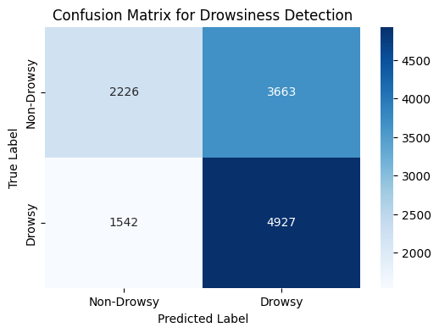
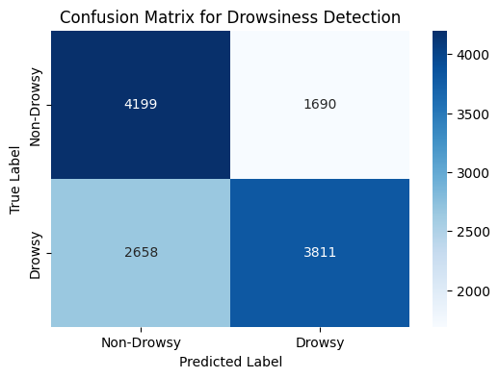
Evaluation
Confusion Matrix for Algorithm 1
Algorithm 1 had an accuracy of 0.58, and performed better at identifying "Drowsy" instances
Hyper Parameters:
EAR Threshold of 0.30
Algorithm 2 had an accuracy of 0.65 and was equally good in identifying “Drowsy” and “Non-Drowsy” instances.
Hyper Parameters:
Eyelid Coverage Threshold of 0.55
Eye Padding of 5 pixels
kernel size of 7 for Sobel Filter
Confusion Matrix for Algorithm 2
Notes:
Evaluation Metrics: Mention the metrics used to evaluate model performance (e.g., accuracy, confusion matrix).
Confusion Matrix and Classification Report: Present key performance results, such as accuracy, precision, recall, and F1-score.

Slide 10
Analysis & Future Work
Analysis
Algorithm 1 performed worse; it is better used with a video stream to detect how long EAR stayed lower than the threshold
Taking into factor eyelid coverage was able to increase the accuracy of the drowsiness classification
Future Work
Other Body languages can be taken into factor to detect drowsiness in a single image such as head bending.
Training A Support Vector Machine (SVM) on the Facial Landmark features and the Eyelid contours

Slide 11

For More Information
GitHub Repo: https://github.com/FranciscoLozCoding/csc481_Project/tree/main
Kaggle Dataset: https://www.kaggle.com/datasets/franciscolozdatasci/csc481-project-dataset
GitHub Repo

Slide 12
References
Albadawi, Y., Takruri, M., & Awad, M. (2022). A review of recent developments in driver drowsiness detection systems. Sensors (Basel), 22(5), 2069. https://doi.org/10.3390/s22052069
Daud, M. A. F., Ismail, A. P., Tahir, N. M., Daud, K., Kasim, N. M., & Mohamad, F. A. (2022). Real-time drowsy driver detection using image processing on Python. 2022 IEEE 12th International Conference on Control System, Computing and Engineering (ICCSCE), 131-136. https://doi.org/10.1109/ICCSCE54767.2022.9935627
Guo, X. (2016). LIME: A method for low-light image enhancement. In Proceedings of the 24th ACM International Conference on Multimedia, 87-91. https://doi.org/10.1145/2964284.2967188
Kazemi, V., & Sullivan, J. (2014). One millisecond face alignment with an ensemble of regression trees. 2014 IEEE Conference on Computer Vision and Pattern Recognition, 1867-1874. https://www.semanticscholar.org/paper/One-millisecond-face-alignment-with-an-ensemble-of-Kazemi-Sullivan/d78b6a5b0dcaa81b1faea5fb0000045a62513567
Kumar, A., & Patra, R. (2018). Driver drowsiness monitoring system using visual behaviour and machine learning. 2018 IEEE Symposium on Computer Applications & Industrial Electronics (ISCAIE), 339-344. https://doi.org/10.1109/ISCAIE.2018.8405495
Nasri, I., Karrouchi, M., Snoussi, H., Kassmi, K., & Messaoudi, A. (2022). Detection and prediction of driver drowsiness for the prevention of road accidents using deep neural networks techniques. In Bennani, S., Lakhrissi, Y., Khaissidi, G., Mansouri, A., & Khamlichi, Y. (Eds.), WITS 2020: Lecture Notes in Electrical Engineering, Vol. 745. Springer, Singapore. https://doi.org/10.1007/978-981-33-6893-4_6
Ni, F., Fu, Z., Cao, Q., & Zhao, Y. (2008). Image processing method for eyes location based on segmentation texture. Sensors and Actuators A: Physical, 143(2), 439-451. https://doi.org/10.1016/j.sna.2007.11.033
Review of recent developments in driver drowsiness detection systems. (n.d.). National Center for Biotechnology Information. Retrieved from https://www.ncbi.nlm.nih.gov/pmc/articles/PMC8914892/
Driver drowsiness monitoring system using visual behaviour and machine learning. (n.d.). IEEE Xplore. Retrieved from https://ieeexplore.ieee.org/document/8405495
Drivers drowsiness detection using image processing and I-Ear techniques. (n.d.). IEEE Xplore. Retrieved from https://ieeexplore.ieee.org/document/10142501

